Slide 1

SLAM3R
Real-Time Dense Scene Reconstruction from Monocular RGB Videos
CVPR 2025
Liu et al.
By VisionNext

Slide 2
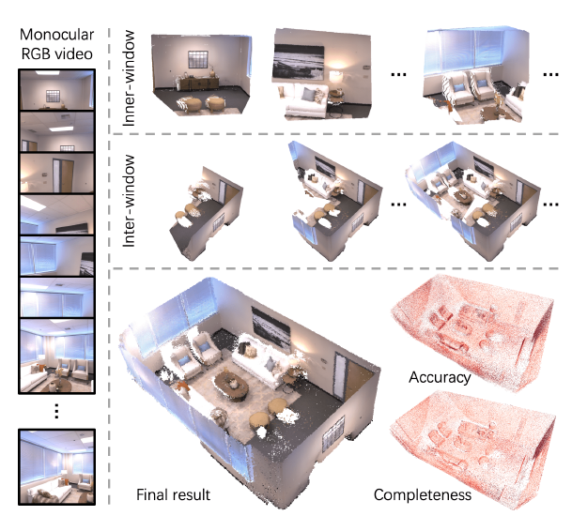
3D Reconstruction
3D reconstruction is the process of capturing the shape and appearance of real objects
Applications include
Augmented Reality (AR) / Virtual Reality (VR)
Robotics & Autonomous Navigation
3D Content Creation
SLAM Enhancement
Real-Time Scene Understanding

Slide 3
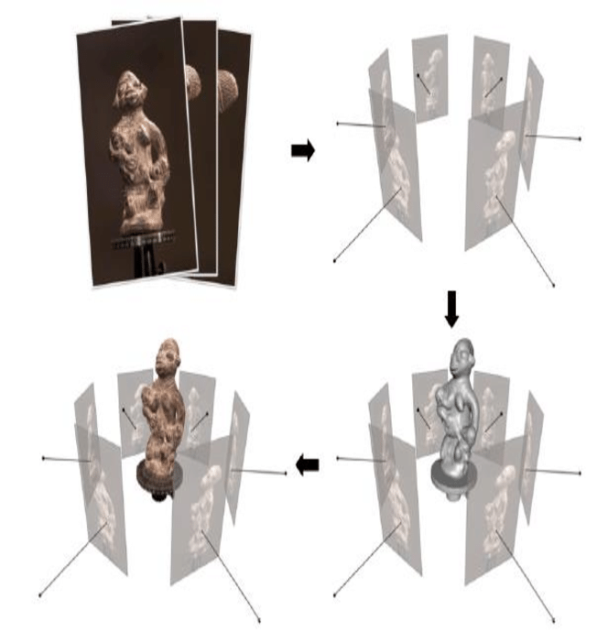
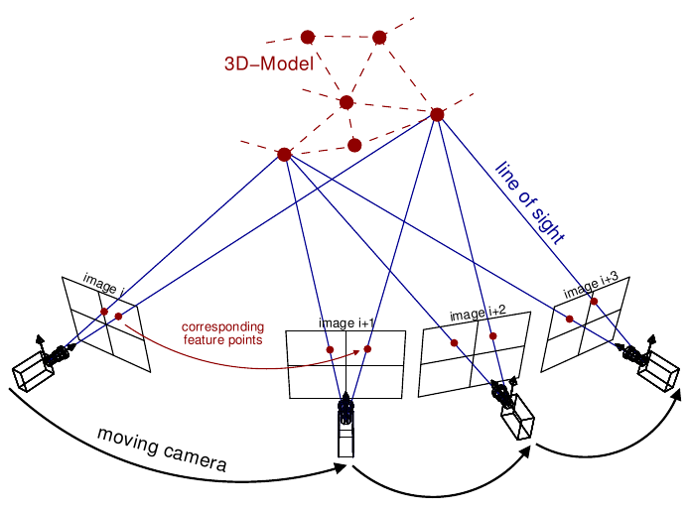
3D Reconstruction
Some methods for reconstruction are Structure from Motion (SfM), Multi View Stereo (MVS) and Monocular SLAM-based reconstructions.
These have certain issues:
SfM: sparse points and require heavy optimization
MVS: Not real-time
Structure from Motion
Multi View Stereo

Slide 4
Motivation for SLAM3R
The goal is to have a method that satisfies the following:
Generates dense points
Has high accuracy
Able to run in real-time
Works with RGB monocular input
SLAM3R is a real-time, end-to-end system for dense reconstruction from monocular RGB videos which satisfies the above requirements without explicit camera pose estimation and no expensive optimization.

Slide 5
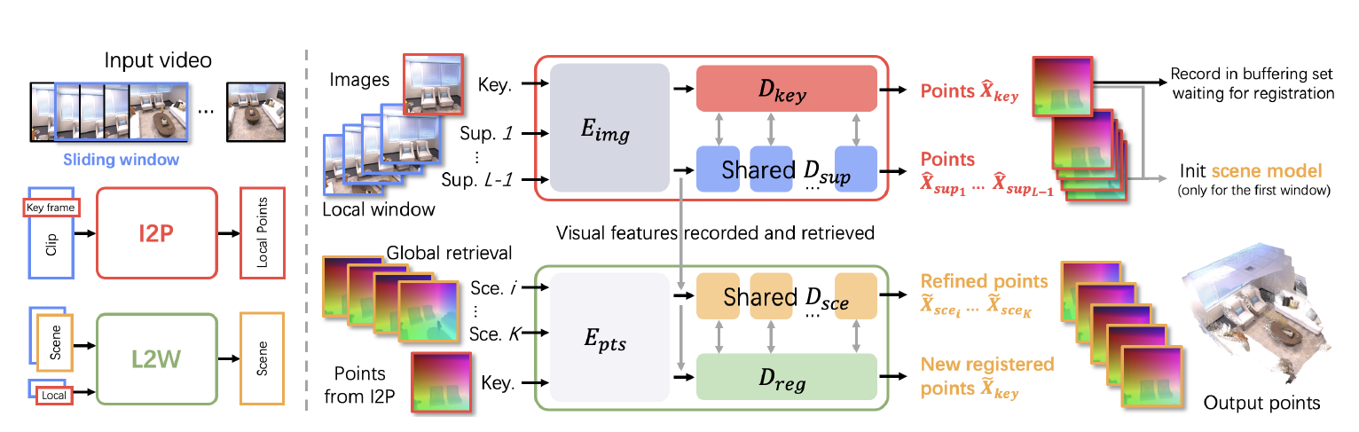
Methodology
The architecture consists of 2 networks:
Image to Point (I2P) - reconstructs local geometry inside a small window of frames.
Local to World (L2W) - aligns these local reconstructions into one global, consistent 3D scene.

Slide 6
I2P Network
The I2P network infers dense 3D point maps for every pixel of a keyframe in a window
Sliding window of images → Feature encoding → Attention fusion → 3D point prediction (per pixel)
Keyframe Decoder
Create windows
Image encoder
Points reconstruction
Supporting Frame Decoder

Slide 7
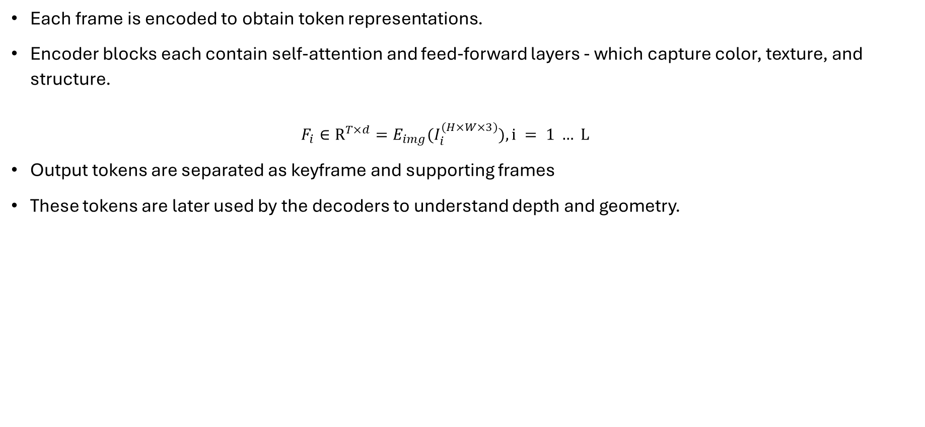
Image Encoder
Each frame is encoded to obtain token representations.
Encoder blocks each contain self-attention and feed-forward layers - which capture color, texture, and structure.
$$F_{i}∈R^{T×d}=E_{img}(I_{i}^{(H×W×3)}), i = 1 … L$$
Output tokens are separated as keyframe and supporting frames
These tokens are later used by the decoders to understand depth and geometry.

Slide 8
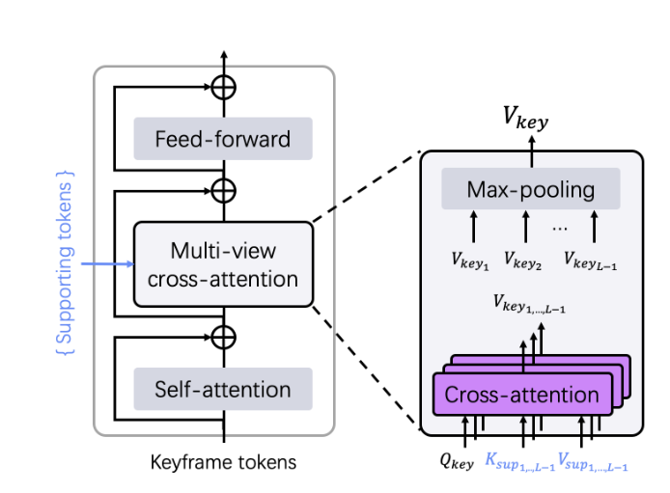
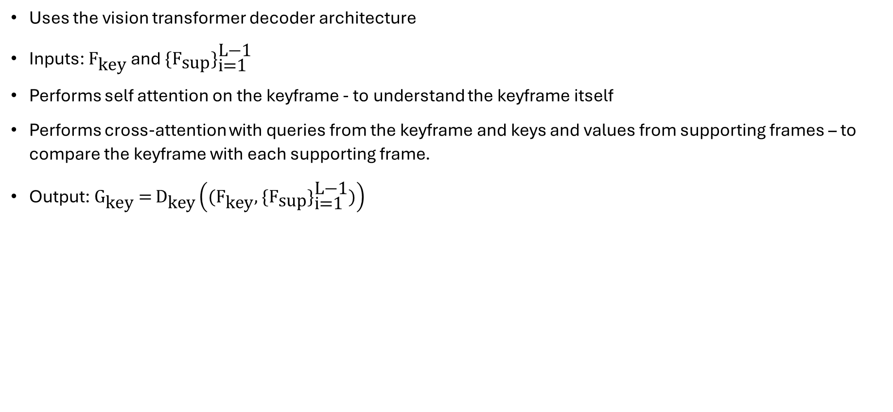
Keyframe Decoder
Uses the vision transformer decoder architecture
Inputs: ${\text{F}}_{\text{key}}$ and $\text{\{}{\text{F}}_{\text{sup}}{\text{\}}}_{\text{i}\text{=1}}^{\text{L}\text{−1}}$
Performs self attention on the keyframe - to understand the keyframe itself
Performs cross-attention with queries from the keyframe and keys and values from supporting frames – to compare the keyframe with each supporting frame.
Output: ${\text{G}}_{\text{key}} \text{=} {\text{D}}_{\text{key}}\left(\text{(}{\text{F}}_{\text{key}}\text{,} \text{\{}{\text{F}}_{\text{sup}}{\text{\}}}_{\text{i}\text{=1}}^{\text{L}\text{−1}}\text{)}\right)$

Slide 9
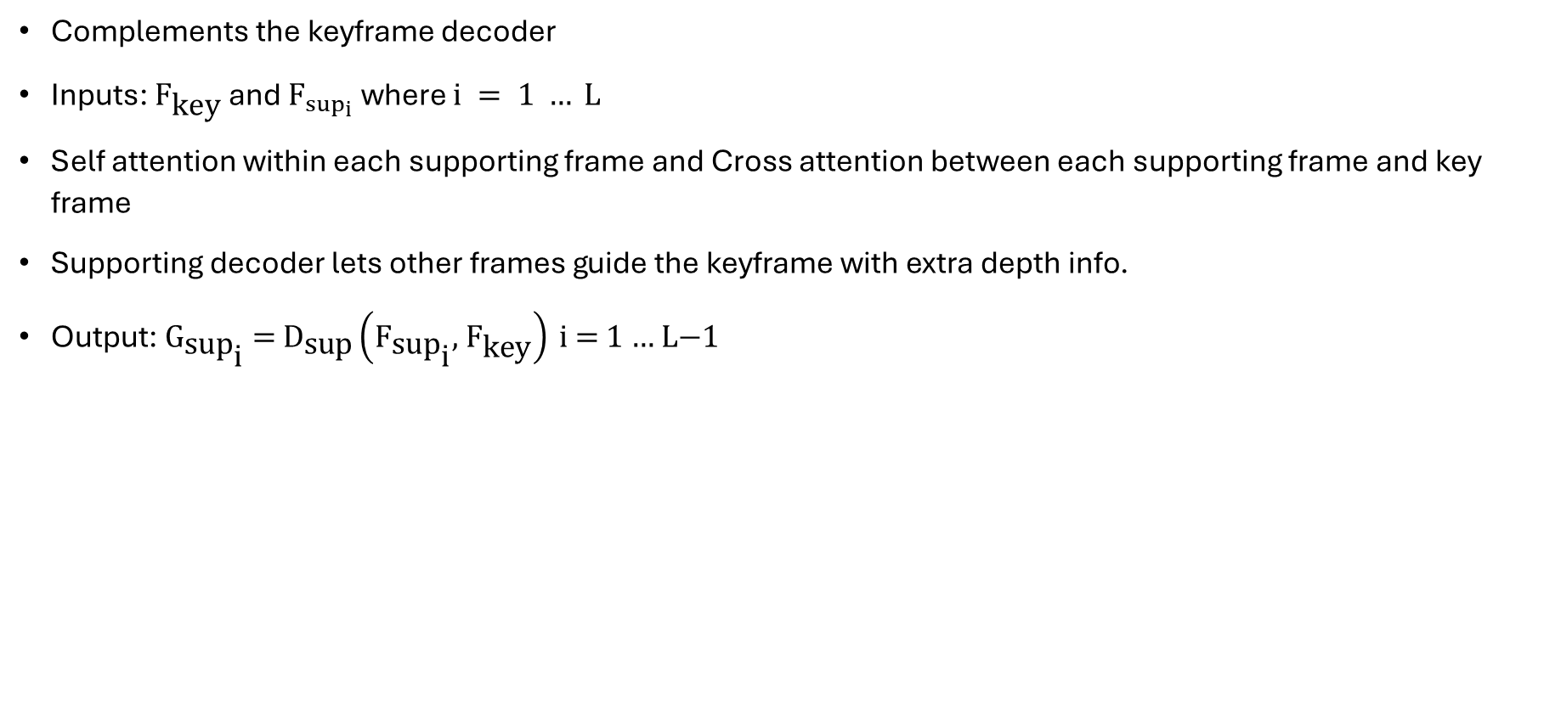
Supporting Decoder
Complements the keyframe decoder
Inputs: ${\text{F}}_{\text{key}}$ and ${\text{F}}_{\sup_{i}}$ where $i = 1 … L$
Self attention within each supporting frame and Cross attention between each supporting frame and key frame
Supporting decoder lets other frames guide the keyframe with extra depth info.
Output: ${\text{G}}_{\text{su}{\text{p}}_{\text{i}}} \text{=} {\text{D}}_{\text{sup}}\left({\text{F}}_{\text{su}{\text{p}}_{\text{i}}}\text{,} {\text{F}}_{\text{key}}\right) \text{i}\text{ = 1 … }\text{L}\text{−1}$

Slide 10
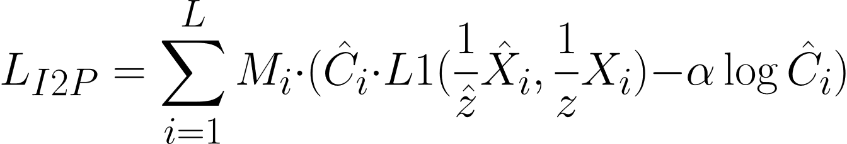
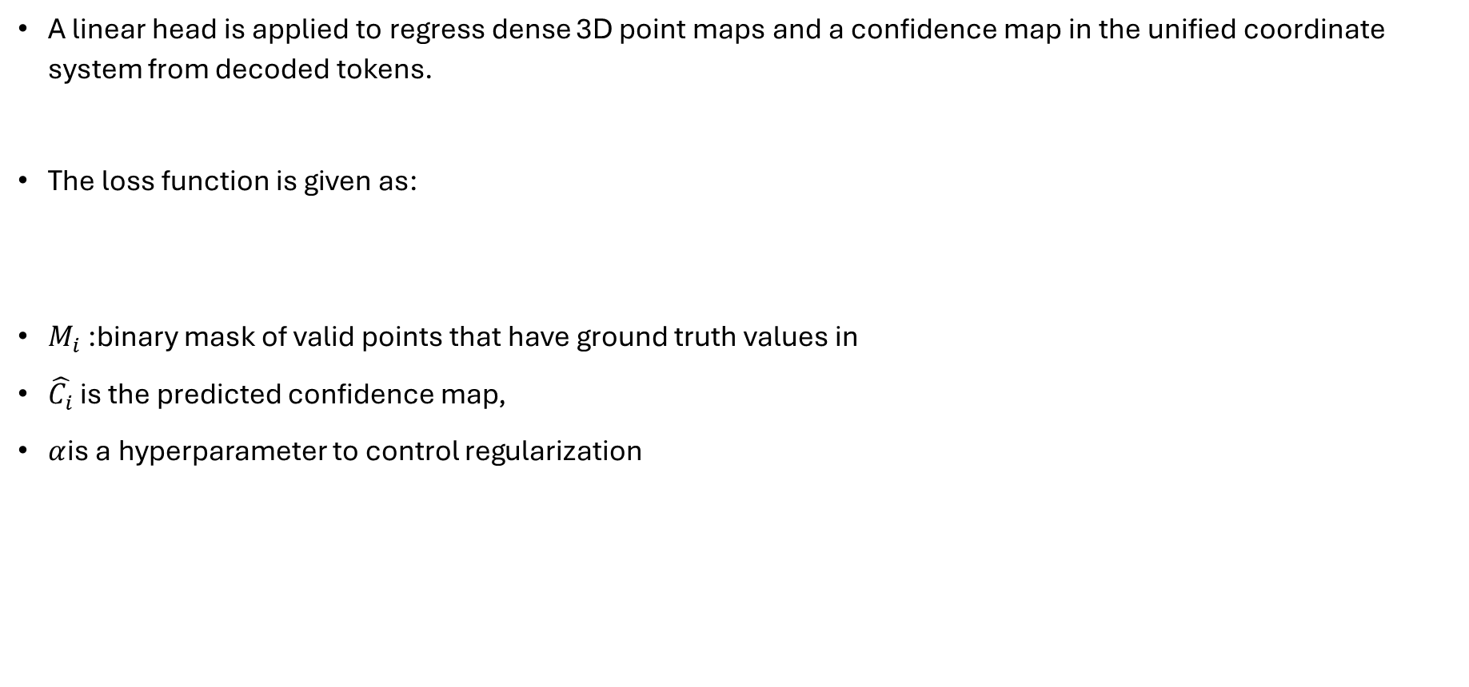
Points Reconstruction
A linear head is applied to regress dense 3D point maps and a confidence map in the unified coordinate system from decoded tokens.
The loss function is given as:
$M_{i}$ :binary mask of valid points that have ground truth values in
$\hat{C_{i}}$is the predicted confidence map,
$α$is a hyperparameter to control regularization

Slide 11
L2W Network
The Local-to-World network incrementally registers the newly generated point map into a global 3D coordinate system
Scene initialization
Registration Decoder
Points reconstruction
Buffer
Scene Decoder

Slide 12
Scene Initialization
The first window is used to initialize the scene
It is crucial for this initialization to be as accurate as possible
The I2P network is run with each frame as the keyframe and the frame with the highest confidence is chosen

Slide 13
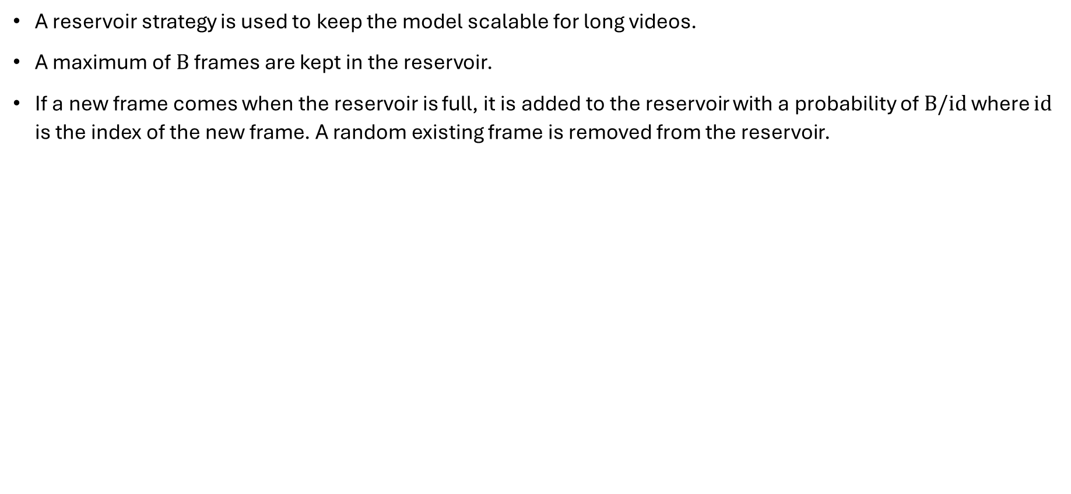
Reservoir
A reservoir strategy is used to keep the model scalable for long videos.
A maximum of $B$ frames are kept in the reservoir.
If a new frame comes when the reservoir is full, it is added to the reservoir with a probability of $B/id$ where $id$ is the index of the new frame. A random existing frame is removed from the reservoir.

Slide 14
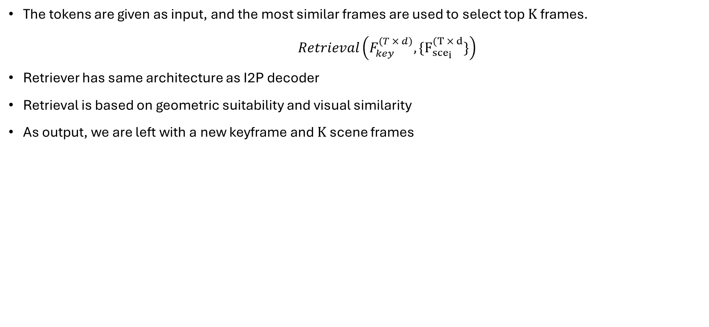
Retrieval
The tokens are given as input, and the most similar frames are used to select top $K$ frames.
$Retrieval\left(F_{key}^{(T × d)}, \{F_{{sce}_{i}}^{(T × d}\}\right)$
Retriever has same architecture as I2P decoder
Retrieval is based on geometric suitability and visual similarity
As output, we are left with a new keyframe and $K$ scene frames

Slide 15
Points Embedding
A patch embedding method is used.
Geometric tokens are encoded as:
Then they are combined with their corresponding visual tokens as

Slide 16
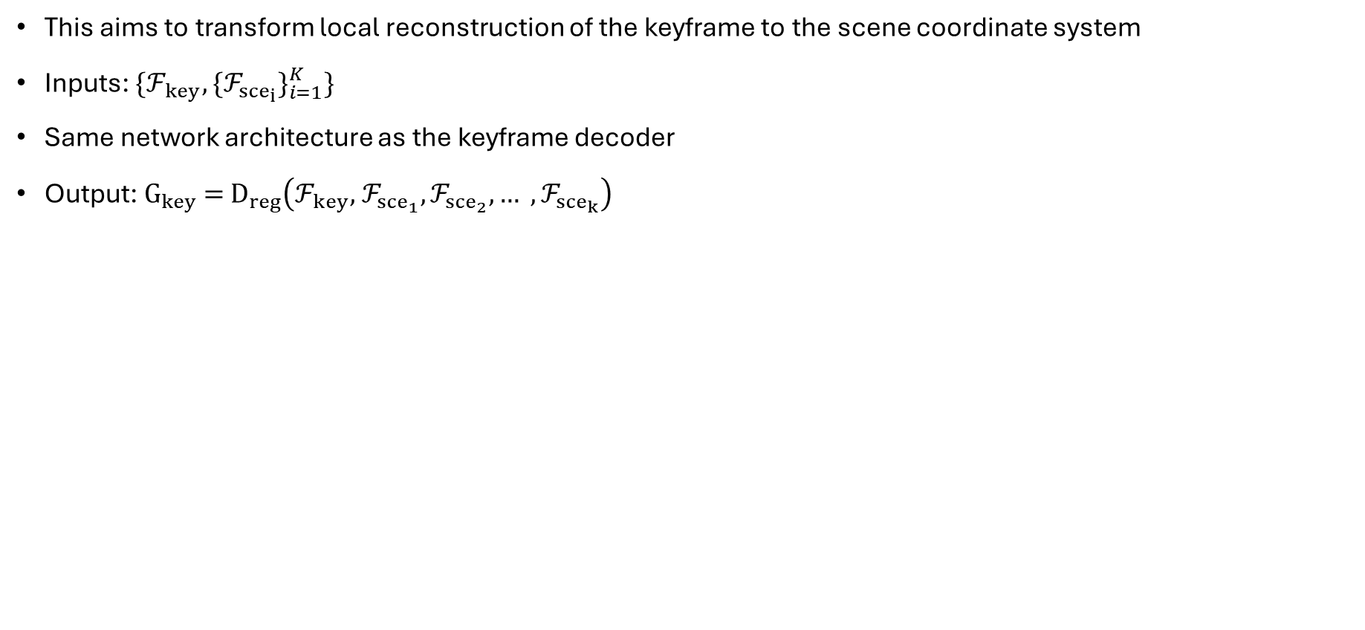
Registration Decoder
This aims to transform local reconstruction of the keyframe to the scene coordinate system
Inputs: $\{ℱ_{key},\{ℱ_{{sce}_{i}}\}_{i=1}^{K}\}$
Same network architecture as the keyframe decoder
Output: ${\text{G}}_{key}\text{ = }{\text{D}}_{reg}\left(ℱ_{key}\text{,} ℱ_{{sce}_{1}},ℱ_{{sce}_{2}}, … ,ℱ_{{sce}_{k}}\right)$

Slide 17
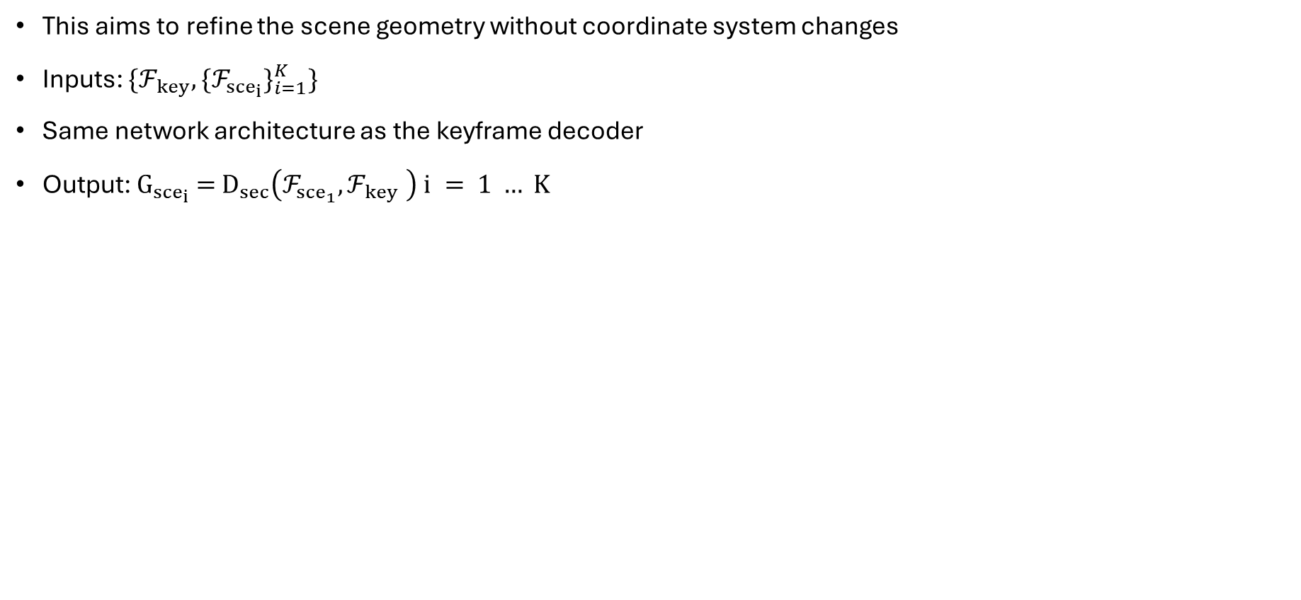
Scene Decoder
This aims to refine the scene geometry without coordinate system changes
Inputs: $\{ℱ_{key},\{ℱ_{{sce}_{i}}\}_{i=1}^{K}\}$
Same network architecture as the keyframe decoder
Output: ${\text{G}}_{{sce}_{i}}\text{ = }{\text{D}}_{sec}\left(ℱ_{{sce}_{1}},ℱ_{key} \right) i = 1 … K$

Slide 18
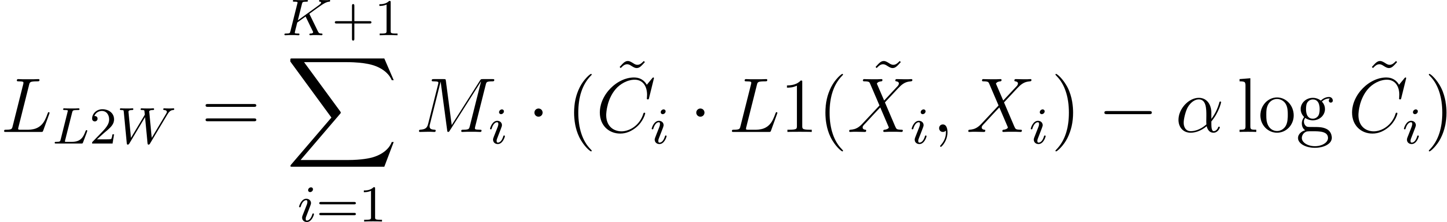
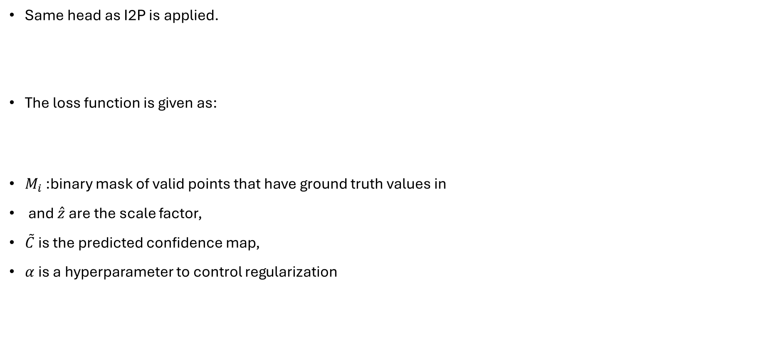
Points Reconstruction
Same head as I2P is applied.
The loss function is given as:
$M_{i}$ :binary mask of valid points that have ground truth values in
and $\hat{z}$are the scale factor,
$\tilde{C}$is the predicted confidence map,
$α$is a hyperparameter to control regularization

Slide 19
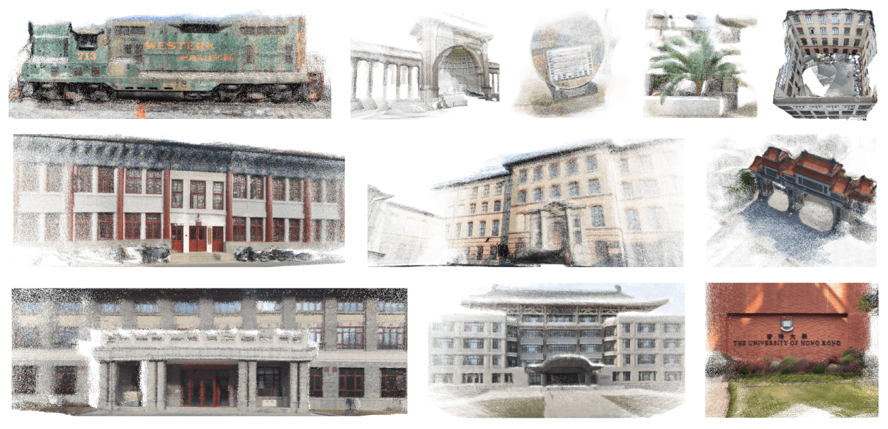
Results

Slide 20
Results

Slide 21
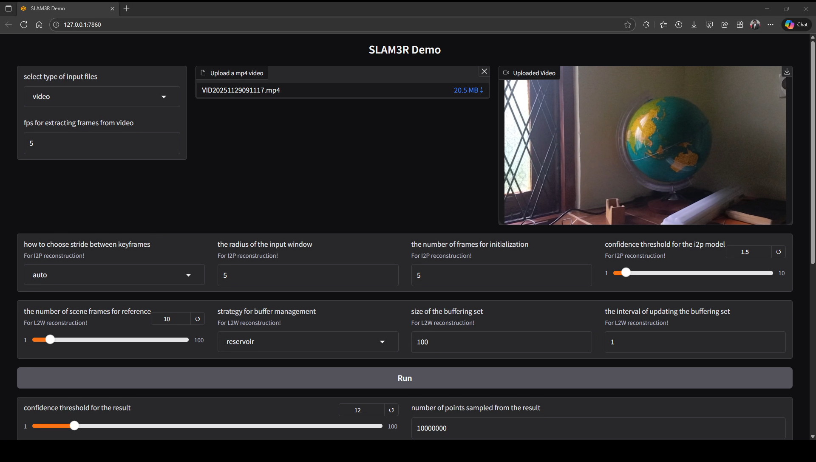

Inference Improvements
Batched the I2P reconstruction to run parallelly on GPUs. This resulted in an approximately 15% improvement.
This can be further improved in GPUs with higher memory. Currently a batch size of 4 is used.
Memory Optimization in batched cross attention: Previously all keys and values were selected for all supporting frames. Added code to check if this is already in memory and use pointers to these instead

Slide 22
Evaluation – 3D Reconstruction Quality
Key Metrics
1. Accuracy (Acc)
Measures how close the reconstructed 3D points are to the true geometry.
Lower value = better (more precise) reconstruction.
2. Completeness (Comp)
Measures how much of the real scene was successfully reconstructed.
Lower value = fewer missing surfaces → more complete 3D model.
3. F-Score (10 / 15 / 20 mm thresholds)
Balanced measure of Accuracy + Completeness.
Higher = better.
f-score20 evaluates tolerance within 20mm, f-score10 is stricter.

Slide 23
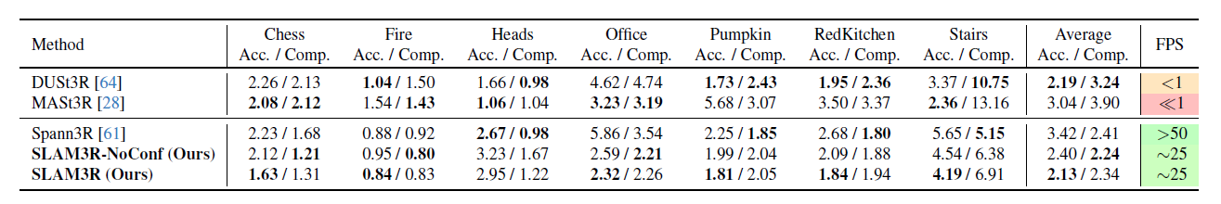
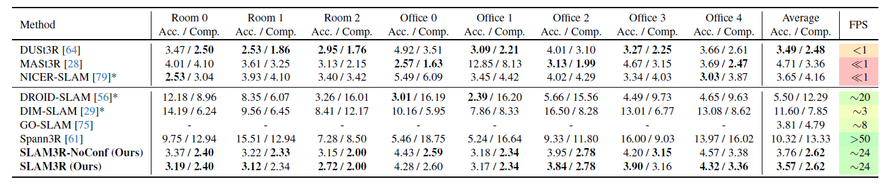
Evaluation
The model was evaluated on the 7 Scenes and Replica datasets
7 Scenes reconstruction results
Replica reconstruction results

Slide 24
Quantitative Results
Scene | Accuracy ↓ | Completeness ↓ | Accuracy ↓ | Completeness ↓ | F-Score@20 ↑ | F-Score@15 ↑ | F-Score@10 ↑
office_0 | 4.28 | 2.60 | 5.112 | 3.133 | 0.288 | 0.184 | 0.081
office_1 | 3.17 | 2.34 | 3.685 | 2.522 | 0.391 | 0.279 | 0.149
office_2 | 3.84 | 2.78 | 3.341 | 2.219 | 0.506 | 0.342 | 0.154
office_3 | 3.90 | 3.16 | 3.427 | 2.455 | 0.411 | 0.260 | 0.113
office_4 | 4.32 | 3.36 | 3.806 | 2.869 | 0.293 | 0.176 | 0.081
room_0 | 3.19 | 2.40 | 2.797 | 2.075 | 0.493 | 0.305 | 0.122
room_1 | 3.12 | 2.34 | 2.724 | 1.919 | 0.544 | 0.370 | 0.167
room_2 | 2.72 | 2.00 | 3.406 | 2.463 | 0.422 | 0.296 | 0.162
chess | 1.63 | 1.31 | 2.404 | 1.487 | 0.757 | 0.659 | 0.473
fire | 0.84 | 0.83 | 1.447 | 1.085 | 0.839 | 0.753 | 0.594
heads | 2.95 | 1.22 | 1.422 | 1.117 | 0.844 | 0.778 | 0.649
office | 2.32 | 2.26 | 2.721 | 2.287 | 0.603 | 0.467 | 0.279
pumpkin | 1.81 | 2.05 | 2.648 | 2.096 | 0.590 | 0.480 | 0.317
redkitchen | 1.84 | 1.94 | 2.897 | 2.122 | 0.572 | 0.448 | 0.279
stairs | 4.19 | 6.91 | 3.568 | 9.816 | 0.286
Key Observations
Highly accurate scenes: fire, heads, chess → lowest accuracy error (<1.5–2.5).
Best completeness: fire, heads → Comp ≈ 1.0 (very complete geometry).
Strong overall F-scores: heads (0.844), fire (0.839) → best combined quality.
Weakest scene: stairs → High completeness error (9.81) due to geometry loss + complex structure.

Slide 25
Conclusion
SLAM3R is a novel and effective system that performs real-time, high-quality, dense 3D scene reconstruction using RGB videos
It employs a two hierarchy neural network framework to perform end-to-end 3D reconstruction
The method generates dense points with high accuracy and is able to run in real-time for RGB monocular input

Slide 26
THANK YOU

